Slide 1
Road Extraction and alert generation for new roads

Slide 2
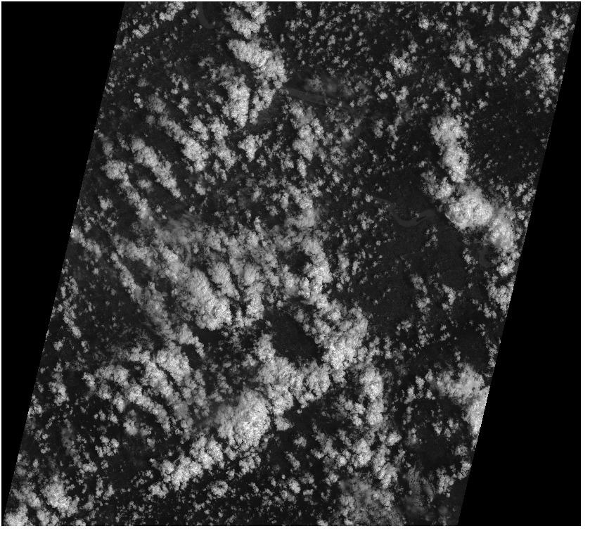
Greyscale image

Slide 3
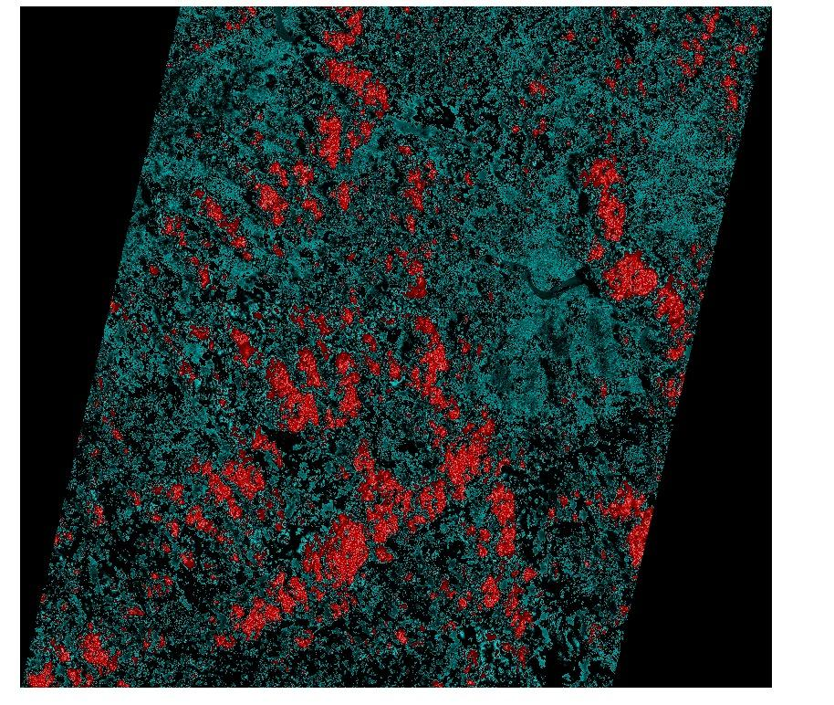
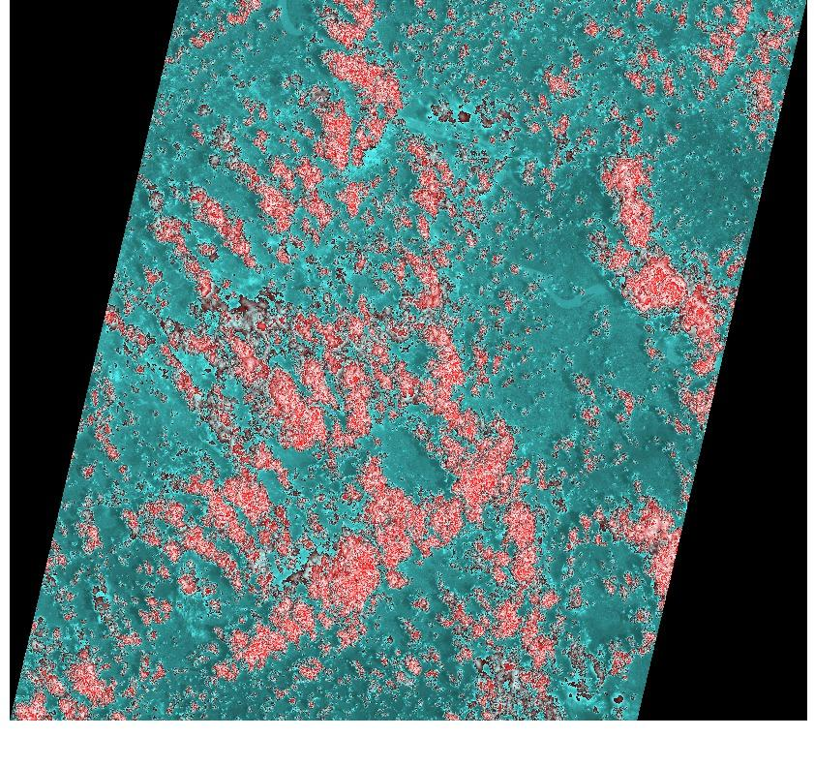
Coloured Image

